Slide 1
Trees
A Plantation of Algorithm in Trees

Slide 2
Team Members
01
02
03
Syed Sami U
Harish K
Introduction & N-Tree
Binary Tree
04
Jayanthan S
Parthasarathy G
Exponential Tree
B & B++ Tree
05
06
Udhaya Kumar K
Muthuram S
Sequencial Tree
Heap Tree & Conclution

Slide 3
01
Introduction
To Trees

Slide 4
What!
Tree Data Structure is a hierarchical data structure in which a collection of elements known as nodes are connected to each other via edges such that there exists exactly one path between any two nodes.

Slide 5
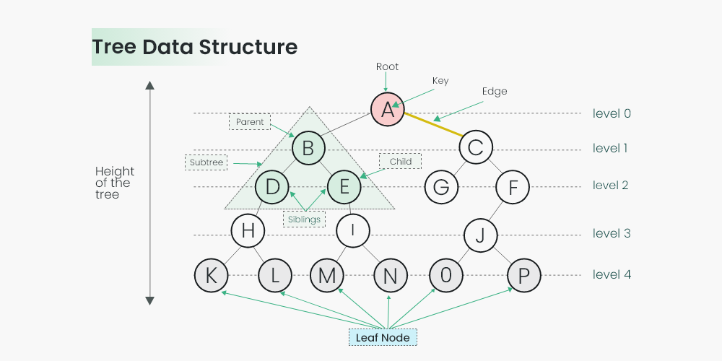

Slide 6
Root:
The topmost node in a tree is called the root. It is the starting point for any traversal or search operation in the tree.
Node:
Each element in a tree is called a node. A node contains data and may also have a reference or links to other nodes (called children).
Edge:
The connection between two nodes in a tree is called an edge. It represents a relationship or link between the nodes.

Slide 7
Edge:
The connection between two nodes in a tree is called an edge. It represents a relationship or link between the nodes.
Leaf:
A leaf node is a node that does not have any children. In other words, it is a node with no outgoing edges.
Height:
The height of a tree is the length of the longest path from the root node to any leaf node. It is the maximum level of any node in the tree.

Slide 8
Parent:
A node in a tree may have one or more child nodes. The node that points to its child node(s) is called the parent node.
Child:
Nodes that are directly connected to a parent node are called child nodes. A parent node may have zero, one, or multiple child nodes.
Sibling:
Nodes that share the same parent node are called siblings. For example, in a binary tree, a parent node can have at most two children, making those two children siblings.

Slide 9
02
Types of
Trees

Slide 10
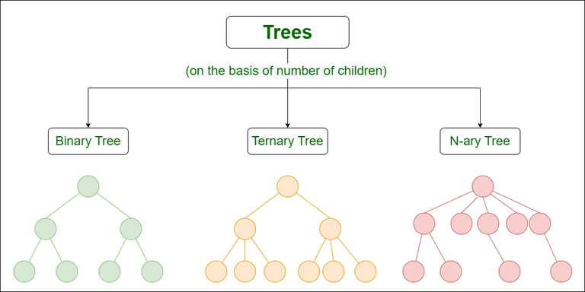

Slide 11
03
N-ary Tree (or)
Generic Tree

Slide 12
The Generic trees are the N-ary trees which have the following properties:
Generic trees are a collection of nodes where each node is a data structure that consists of records and a list of references to its children.
Many children at every node.
The number of nodes for each node is not known in advance.

Slide 13
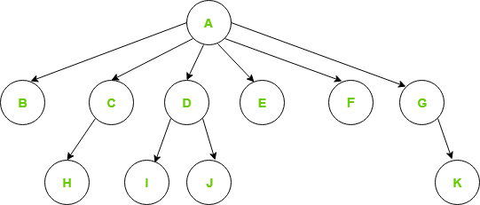
Generic Tree

Slide 14
Program
struct Node{
int data;
Node *firstchild;
Node *secondchild;
Node *thirdchild;
Node *fourthchild;
Node *fifthchild;
Node *sixthchild;
};

Slide 15
Disadvantages of the above representation are:
Memory Wastage – All the pointers are not required in all the cases. Hence, there is lot of memory wastage.
Unknown number of children – The number of children for each node is not known in advance.

Slide 16
04
Binary Tree
Binary Algorithm

Slide 17
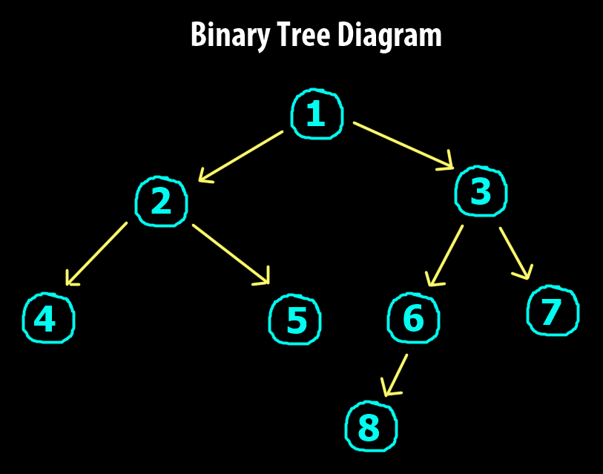
Binary Tree ADT
A binary tree is a tree data structure in which each node has at most two children.
A binary tree is a finite set of nodes which is either empty or consists of a root and two disjoint binary trees.

Slide 18
Types of Binary Trees
Types of Binary Tree based on the number of children:
Full Binary Tree.
Degenerate Binary Tree.
Skewed Binary Trees.
Types of Binary Tree On the basis of the completion of levels:
Complete Binary Tree.
Perfect Binary Tree.
Balanced Binary Tree.

Slide 19
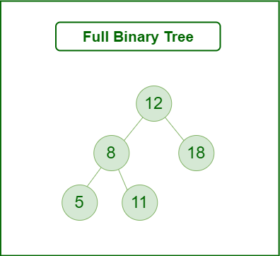
Full Binary Tree
A Binary Tree is a full binary tree if every node has 0 or 2 children. We can also say a full binary tree is a binary tree in which all nodes except leaf nodes have two children.

Slide 20
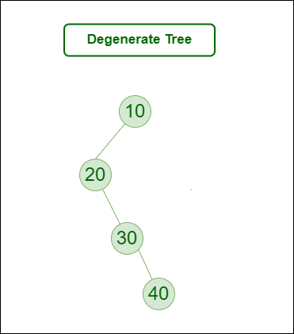
Degenerate tree
A Tree where every internal node has one child. Such trees are performance-wise same as linked list.
A degenerate or pathological tree is a tree having a single child either left or right.

Slide 21
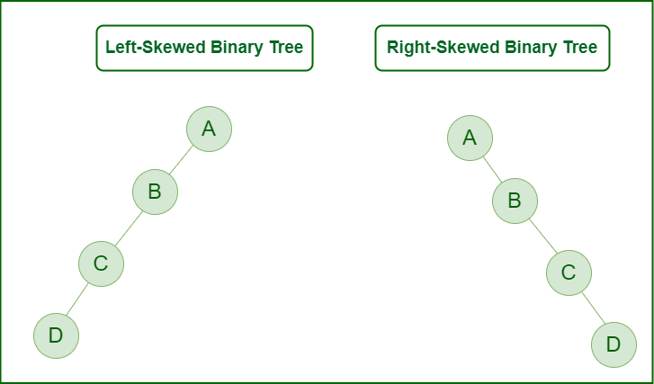
Skewed Binary Tree
A skewed binary tree is a pathological/degenerate tree in which the tree is either dominated by the left nodes or the right nodes.
Thus, there are two types of skewed binary tree:
Left-skewed binary tree.
Right-skewed binary tree.

Slide 22
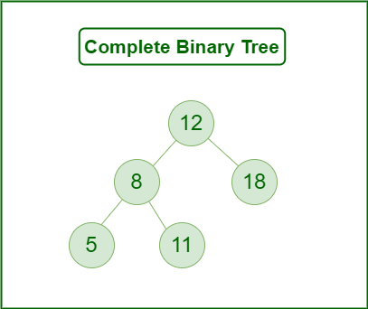
Complete Binary Tree
A Binary Tree is a Complete Binary Tree if all the levels are completely filled except possibly the last level and the last level has all keys as left as possible.

Slide 23
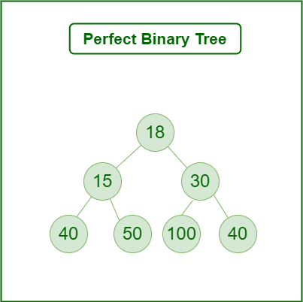
Perfect Binary Tree
A Binary tree is a Perfect Binary Tree in which all the internal nodes have two children and all leaf nodes are at the same level.

Slide 24
Balanced Binary Tree
A binary tree is balanced if the height of the tree is O(Log n) where n is the number of nodes.
For Example, the AVL tree maintains O(Log n) height by making sure that the difference between the heights of the left and right subtrees is at most 1.
Balanced Binary Search trees are performance-wise good as they provide O(log n) time for search, insert and delete.

Slide 25
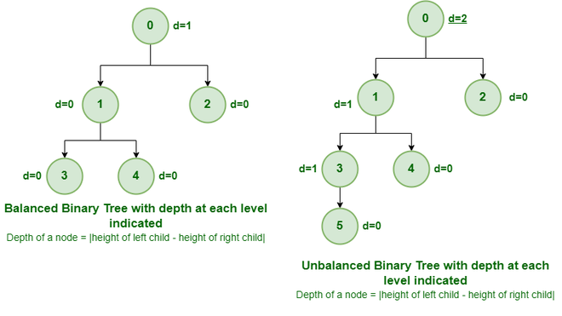

Slide 26
Exponential Tree
05

Slide 27
What!
Expression Tree is a binary tree in which the leaf nodes are operands and the interior nodes are operators.
The Expression tree is a binary trees because all of the operations are binary
Ex : A+B*C
+
A
*
B
C

Slide 28
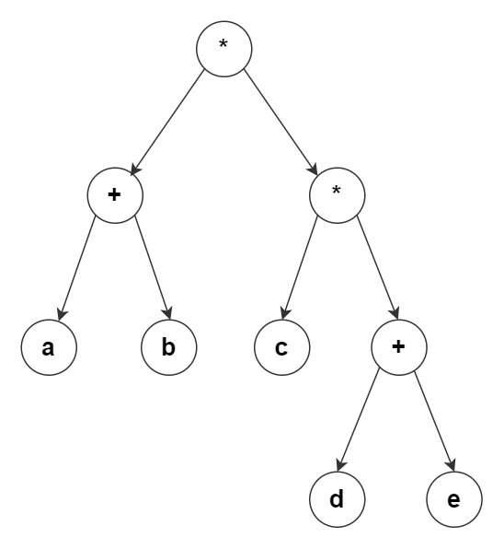
Create an Expression Tree
For example, the postfix notation a b + c d e + * results in the following expression tree.

Slide 29
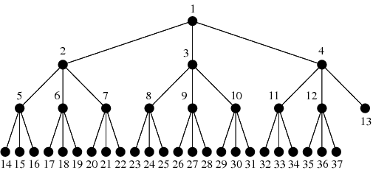
Exponential Tree Growth

Slide 30
Program for Exponential Tree
p = num / den
import math
class Node:
def __init__(self, key):
self.key = key
self.left = None
self.right = None
def newNode(key):
temp = Node(key)
return temp
def find_x(n):
if n == 1:
return 1
num = math.log10(n)
x, no = 0, 0
for i in range(2, n + 1):
den = math.log10(i)
p = num / den

Slide 31
no = int(pow(i, int(p)))
if abs(no - n) < 1e-6:
x = i
break
return x
def is_key(n, x):
p = math.log10(n) / math.log10(x)
no = int(pow(x, int(p)))
if n == no:
return True
return False
def evenPaths(node, count, x):
if node == None or not is_key(node.key, x):
return count
if node.left == None and node.right == None:
count+=1
count = evenPaths(node.left, count, x)
return evenPaths(node.right, count, x)

Slide 32
def countExpPaths(node, x):
return evenPaths(node, 0, x)
root = newNode(27)
root.left = newNode(9)
root.right = newNode(81)
root.left.left = newNode(3)
root.left.right = newNode(10)
root.right.left = newNode(70)
root.right.right = newNode(243)
root.right.right.left = newNode(81)
root.right.right.right = newNode(909)
x = find_x(root.key)
print(countExpPaths(root, x))
OUTPUT : 2

Slide 33
06
B & B++ Tree

Slide 34
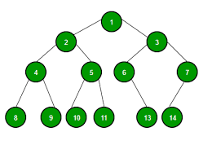
Introduction
This presentation provides a comprehensive overview of B&B++ trees and how they can enhance data retrieval efﬁciency.
B&B+rees are a type of balanced tree data structure that have been shown to outperform traditional B-trees in certain scenarios.

Slide 35
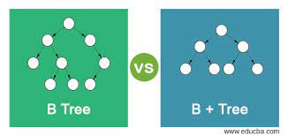
What are B & B+ Trees ?
B&B++ trees are a type of balanced tree data structure that extend the traditional B-tree. They were introduced in 2011 by researchers at the University of Waterloo. B&B++ trees are designed to reduce the number of disk accesses required to retrieve data from a database. They achieve this by using a novel technique called bulk loading.

Slide 36
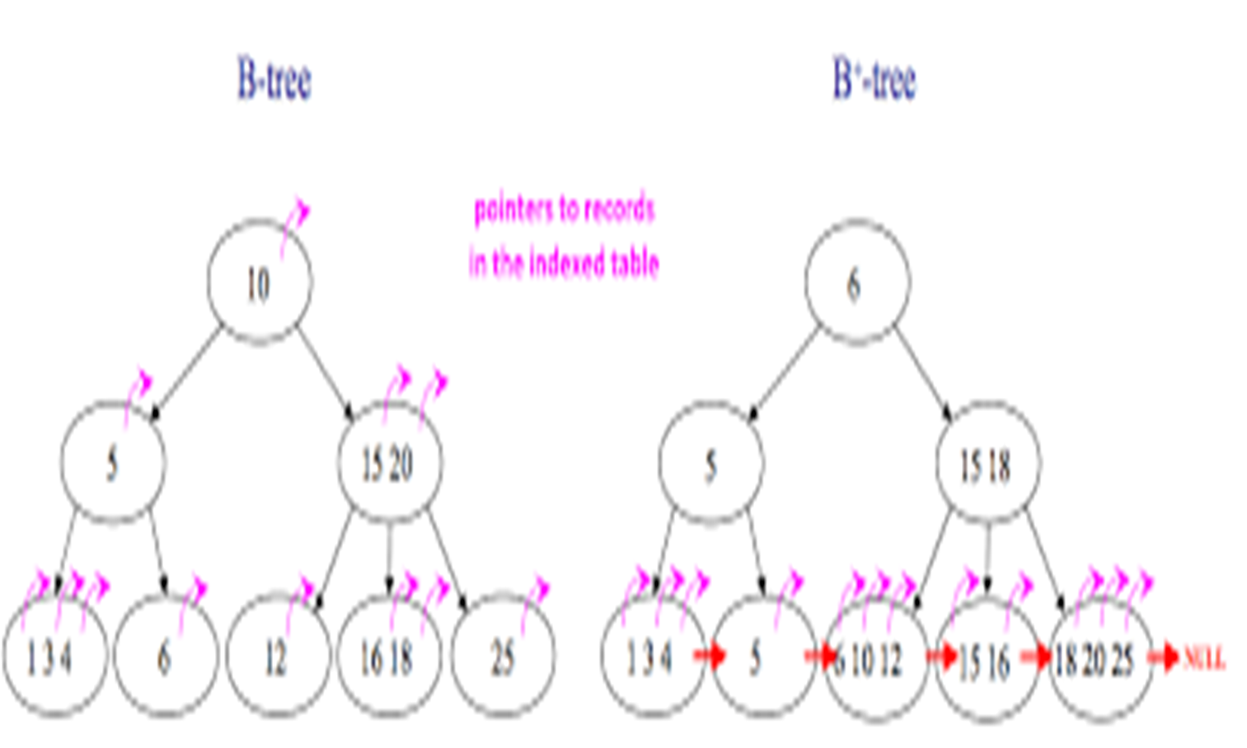
Advantages of B & B+ Trees
There are several advantages to using B&B++ trees over traditional B-trees. Firstly, B&B++ trees can reduce the number of disk accesses required to retrieve data from a database, which can signiﬁcantly improve performance.
Secondly, B&B++ trees can be loaded more quickly than traditional B-trees.

Slide 37
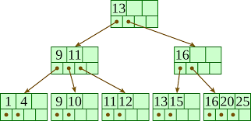
Limitation of B&B+ Trees
While have many advantages, there are also some limitations to consider. Firstly, B&B++ trees require more memory than traditional B-trees, which can be a concern in some scenarios. Secondly, B&B++ trees can be more difﬁcult to implement than traditional B- trees.

Slide 38
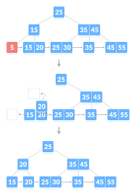
Application of B & B+ Trees
There are many scenarios where B&B++ trees can be useful.
For example, B&B++ trees are particularly well-suited to scenarios where data is frequently updated or deleted.
They are also useful in scenarios where data retrieval efﬁciency is critical, such as in real-time systems.

Slide 39
Sequencial
Tree
07

Slide 40
Sequential Tree
Binary Representation:
A sequential tree is one in which the nodes are stored in a sequential order.
This means that the nodes can be traversed in a linear order, similar to an array.
A
B
C
D
E
F
H
Sequential Representation:
A | B | C | D | - | E | F | - | H

Slide 41
Properties of Sequential Trees
Sequential trees are efficient for storing and retrieving data in sequential order.
Sequential trees are also efficient for inserting and deleting data in sequential order.
Sequential trees are not as efficient for searching for data in non-sequential order.

Slide 42
Application of Sequential Trees
Compilers for representing and manipulating expressions
Operating systems for managing processes and threads
Databases for indexing and retrieving data
Graphics for drawing lines and curves

Slide 43
Heap Tree
08

Slide 44
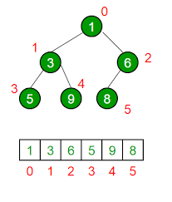
DEFINITION
A heap tree is a complete binary tree .
In which the data values stored in any node is greater than or equal to the value of each of its children (if any).
A heap tree must satisfy the following two properties:
Structure property
Heap property

Slide 45
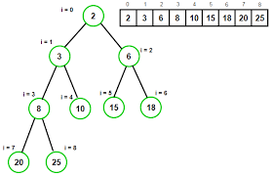
Structure property: The tree must be a complete binary tree, meaning that all levels of the tree must be full except the bottom level, which may be partially full.
Heap property: For any given node C, if P is a parent node of C, then the key (the value) of P is greater than or equal to the key of C.

Slide 46
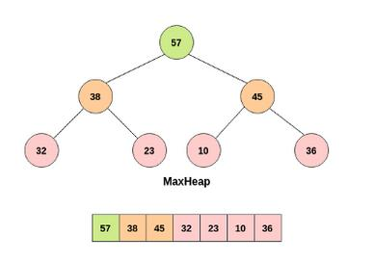
TYPES OF HEAP TREE
Max heap: In a max heap, the value of the root node is always the largest value in the tree.

Slide 47
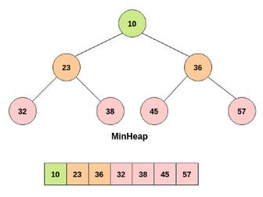
Min heap: In a min heap, the value of the root node is always the smallest value in the tree.

Slide 48
HEAP OPERATIONS
Insert: Inserts an element into the heap.
Remove: Removes the root element from the heap.
Peek: Returns the root element of the heap without removing it.
Heapify: Converts an arbitary binary tree into a heap tree.

Slide 49
Conclusion
As we have seen, trees are a powerful data structure with many applications. Trees are used in computer science for various tasks, including storing information, representing hierarchical data, and providing efficient algorithms for operations such as insertion, deletion, and searching

Slide 50
Thank You!

